Slide 1
Why is US Health Care expensive?

Slide 2
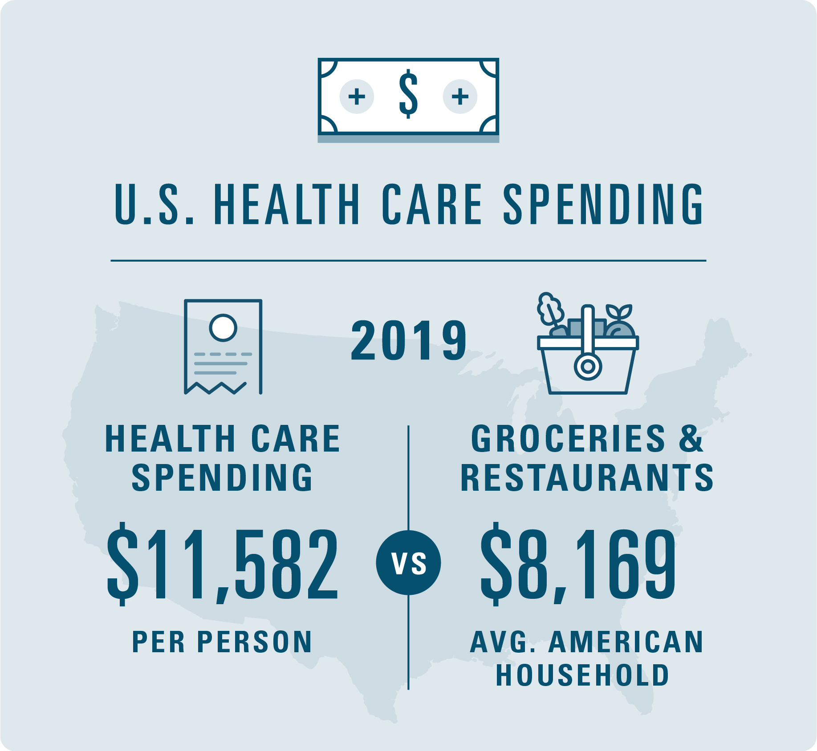
If you have ever wondered why health care in United State is so expensive, You are not alone
Notes:
It is often straining the budget of families and business alike. In 2019, , U.S health care spending grew 4.6 percent , rising to $11,582 per person. To put that into perspective, in 2019 , the average American household spending $8,169 on Groceries and going to restaurant. That is right ,health care cost more per person than the cost to feed an entire household for a year. Addressing health care cost in our country is no small feat. It requires significant action , including setting the right health care policies at both the federal and state level.

Slide 3
Let talk about four key factors that impact cost in US Health care.
Notes:
Prescription Drug
Medicare cost
Chronic Disease and Population Health
Administrative Burden and Waste

Slide 4
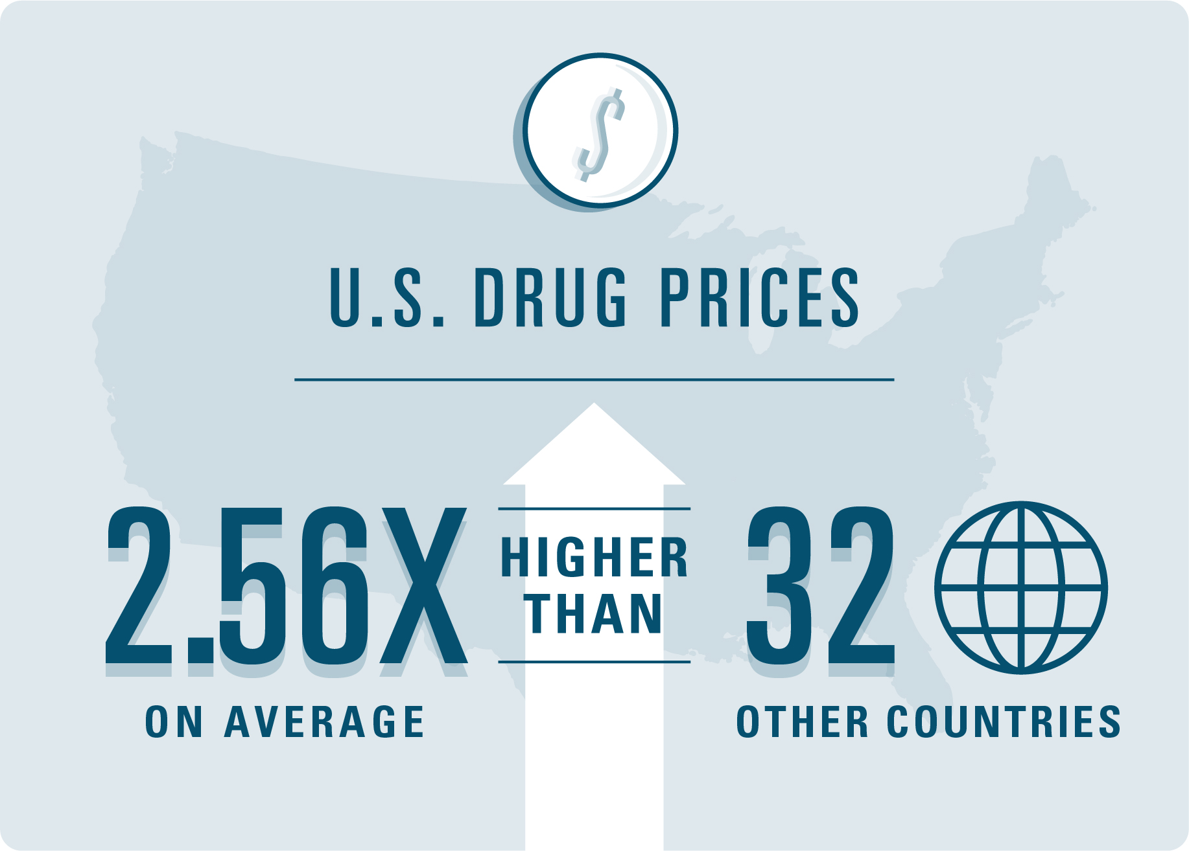
Prescription Drug Cost
Prescription Drug plays a critical and often lifesaving , role in preventing and managing care for Americans. But the price tag attached directly impact overall health care cost.
Notes:
The U.S. has significantly higher drug prices than other countries – averaging 2.56 times higher than 32 other countries and that number only continues to grow. In 2019, retail prescription rug spending reached $329.7 billion, a 5.7 percent increase compared to 3.8 percentage increase in 2018.
One reason for high cost is the price of brand-name versus generic prescription drugs. While generic medications makes up 84% of prescription filled per year, they only account 12% of the total spending. By increasing access to generic prescription drug, we can positively impact the overall cost of health care. As a matter of fact , generic drug has saved consumer $253 billion in 2017 and more than $1 trillion over the past decade.

Slide 5
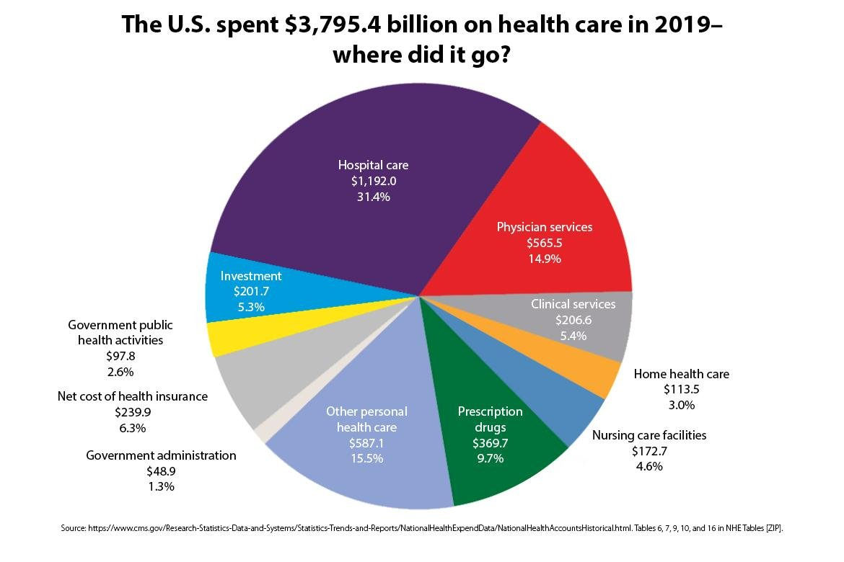
Medical Care cost
It may go without saying , but the cost of medical care itself also plays a significant role in the overall cost of health care. That is all from x-rays to hospitals stays
Notes:
In 20219 ,spending on hospital care service reached $1.2 trillion. Physician and clinical services spending surpassed $770 billion. That increased use and intensity of these services contributed to the cost. We also see impact from new technology and therapies, provider consolidation and location where services are performed.

Slide 6
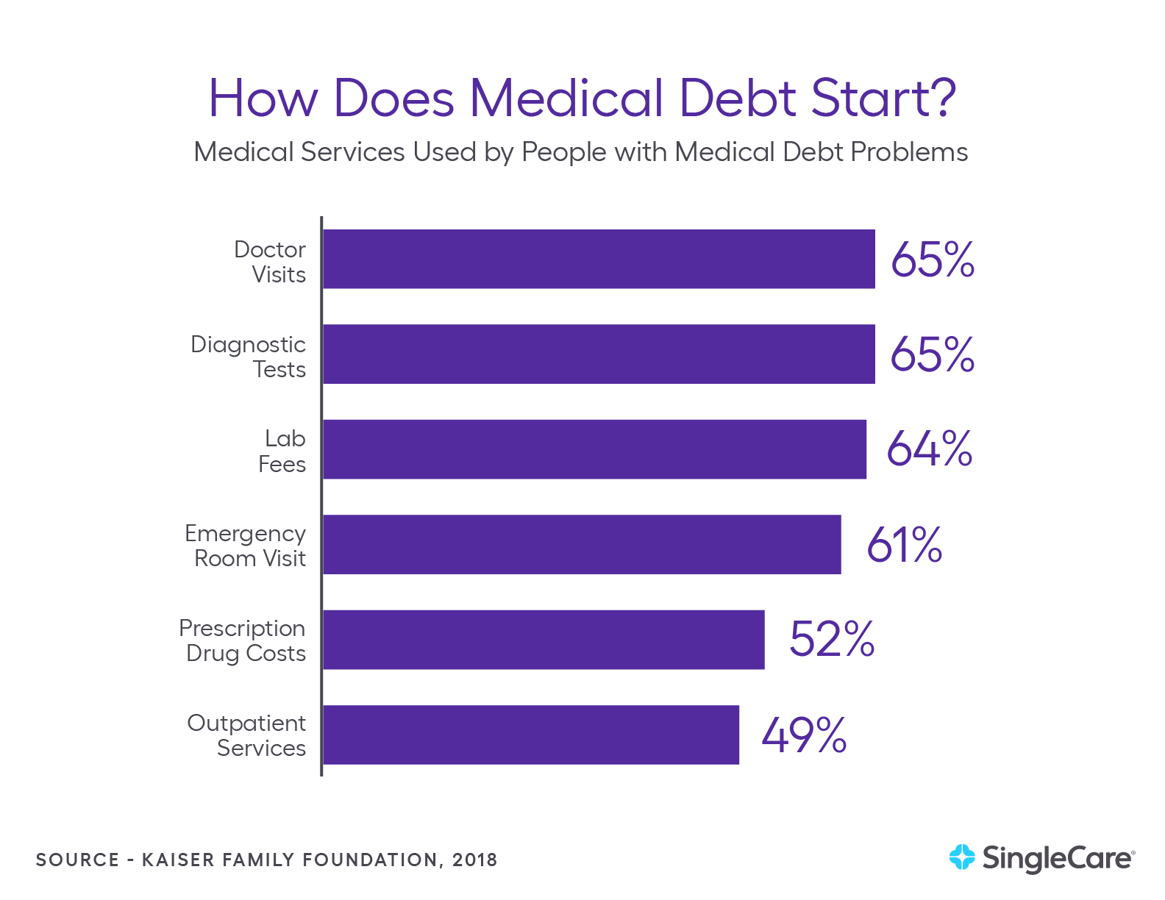
How does Medical Debt Start?
One recent survey identified the specific medical services that lead to medical debt. Among the report services that led to problems with medical bills .
Notes:
48% of people who experienced medical bankruptcy named hospital bills as their biggest expenses(American Journal of Medicine,2009)
18.6% of people who experienced medical bankruptcy named prescription drug as their biggest expense.
15.1% of people who experienced medical bankruptcy named doctor bills as their biggest expense.
4.1% of people who experienced medical bankruptcy named premiums as their biggest expense.
Out-of –pocket medical cost averaged $17,943 for medically bankrupt families.

Slide 7
Who is paying U.S Medical Costs?
The burden of high cost of U.S. Medicine is borne nearly equally by government , individual and businesses.
Notes:
The federal government pays 28% of total U.S. health expenditures. (California Health Care Foundation, 2019)
Individuals and households pay 28% of total U.S. health expenditures. (California Health Care Foundation, 2019)
Private businesses pay 20% of total U.S. health expenditures. (California Health Care Foundation, 2019)
State and local governments pay 17% of total U.S. health expenditures. (California Health Care Foundation, 2019)
Other private organizations, such as nonprofits, pay 7% of total U.S. health expenditures. (California Health Care Foundation, 2019)
On average, 37% of a household’s total health spending goes toward out-of-pocket expenses. (California Health Care Foundation, 2019)
On average, 28% of a household’s total health spending goes toward their share of employer-sponsored health insurance. (California Health Care Foundation, 2019)
On average, 17% of a household’s total health spending goes toward supporting Medicare via the payroll tax. (California Health Care Foundation, 2019)
Total spending on private health insurance in the U.S. is $1.2 trillion. (California Health Care Foundation, 2019)
45% of the total amount spent on private health insurance is covered by private businesses. (California Health Care Foundation, 2019)
23% of the total amount spent on private health insurance is covered by the government (mostly, as contributions to employer-sponsored health plans). (California Health Care Foundation, 2019)
Total U.S. out-of-pocket spending per Capita has risen from $91 in 1967 to $1,124 in 2017. (California Health Care Foundation, 2019)

Slide 8
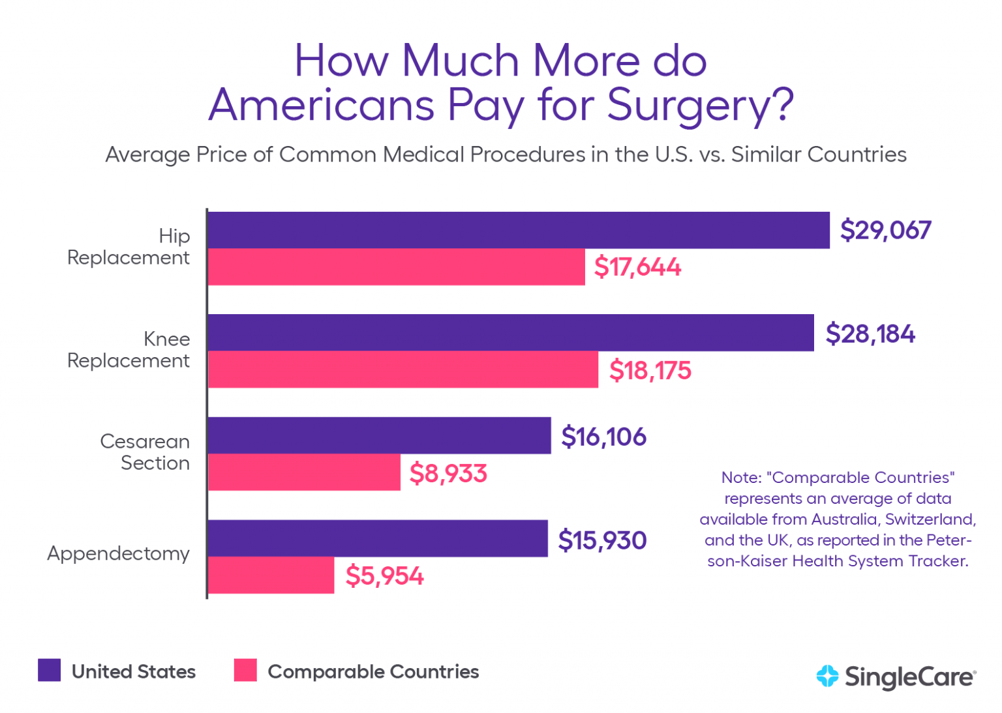
How U.S. Health Care costs compare with other countries
American may be suffering from higher levels of medical debt because, in part, of the high cost of care in the U.S. People in countries with lower healthcare costs are not as susceptible to medical dept and bankruptcy
Notes:
The average hospital stays cost per day in the U.S. is $5,220. The average hospital stay cost per day in Australia is $765. (Kaiser Family Foundation, 2018)
The average cost for heart bypass surgery in the U.S. is $78,318. The average costs for heart bypass surgery in the U.K. is $24,059.
U.S doctors perform 322 cesarean sections per 1000 live births. The average among similarly wealthy countries is 264 c-section per 1,000 live births.
The average price of a normal birth delivery in the U.S. is $10,808. The average price of a normal birth delivery in Australia is $5,312.
The average price of a cesarean section in the U.S. is $16,106. The average price of C-section in Australia is $215.
The average price of appendectomy in the U.S. is $15,930. The average price of an appendectomy in the united kingdom is $8,009.
The average price of a hip replacement in the U.S. is $29,067. The average price of hip replacement in the United Kingdom is $16,335.
The average price of Humira, a drug used for the treatment of arthritis, is about 96% higher in the United States than in United Kingdom.
The average cost of a CT scan in the U.S. scan in then U.S($896) is eight times higher than in Canada ($97).

Slide 9
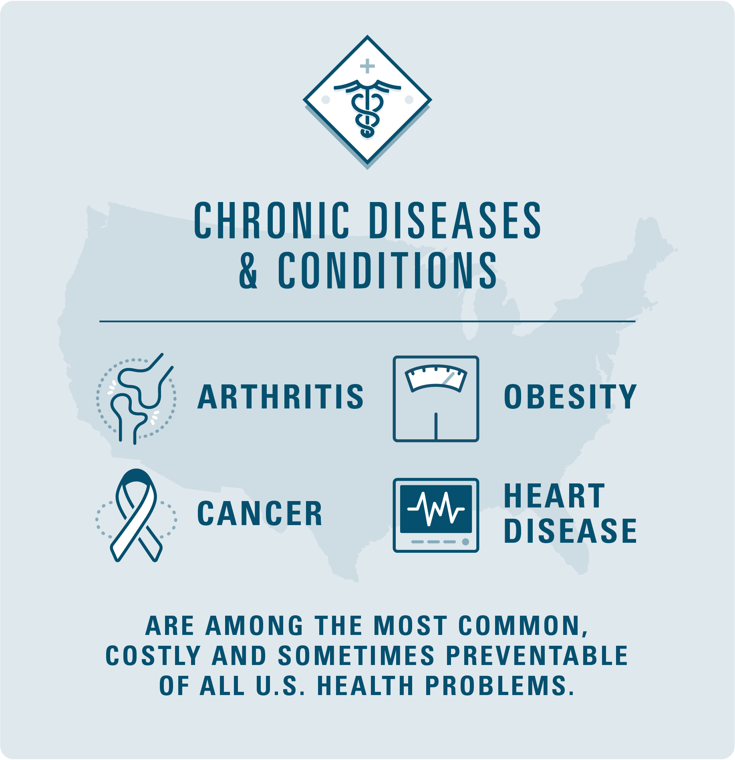
Chronic Disease and Population Health
Treating chronic diseases and condition also leads to high cost of care. While the U.S. spends much more than other countries on health care , we still achieve worse population health outcomes
Notes:
According to Blue Cross and Blue Shield Association , chronic diseases and conditions- such as arthritis, obesity, cancer and heart diseases- are among the most common ,costly and sometimes preventable of all U.S. health problems.
By preventing diseases before they occur, we can begin to chip away at the overall expense's health care in the U.S.
Additionally , drivers of health can impact the overall cost of care. These factors include socioeconomic status , food security, education, community environment , access to health care and more.

Slide 10
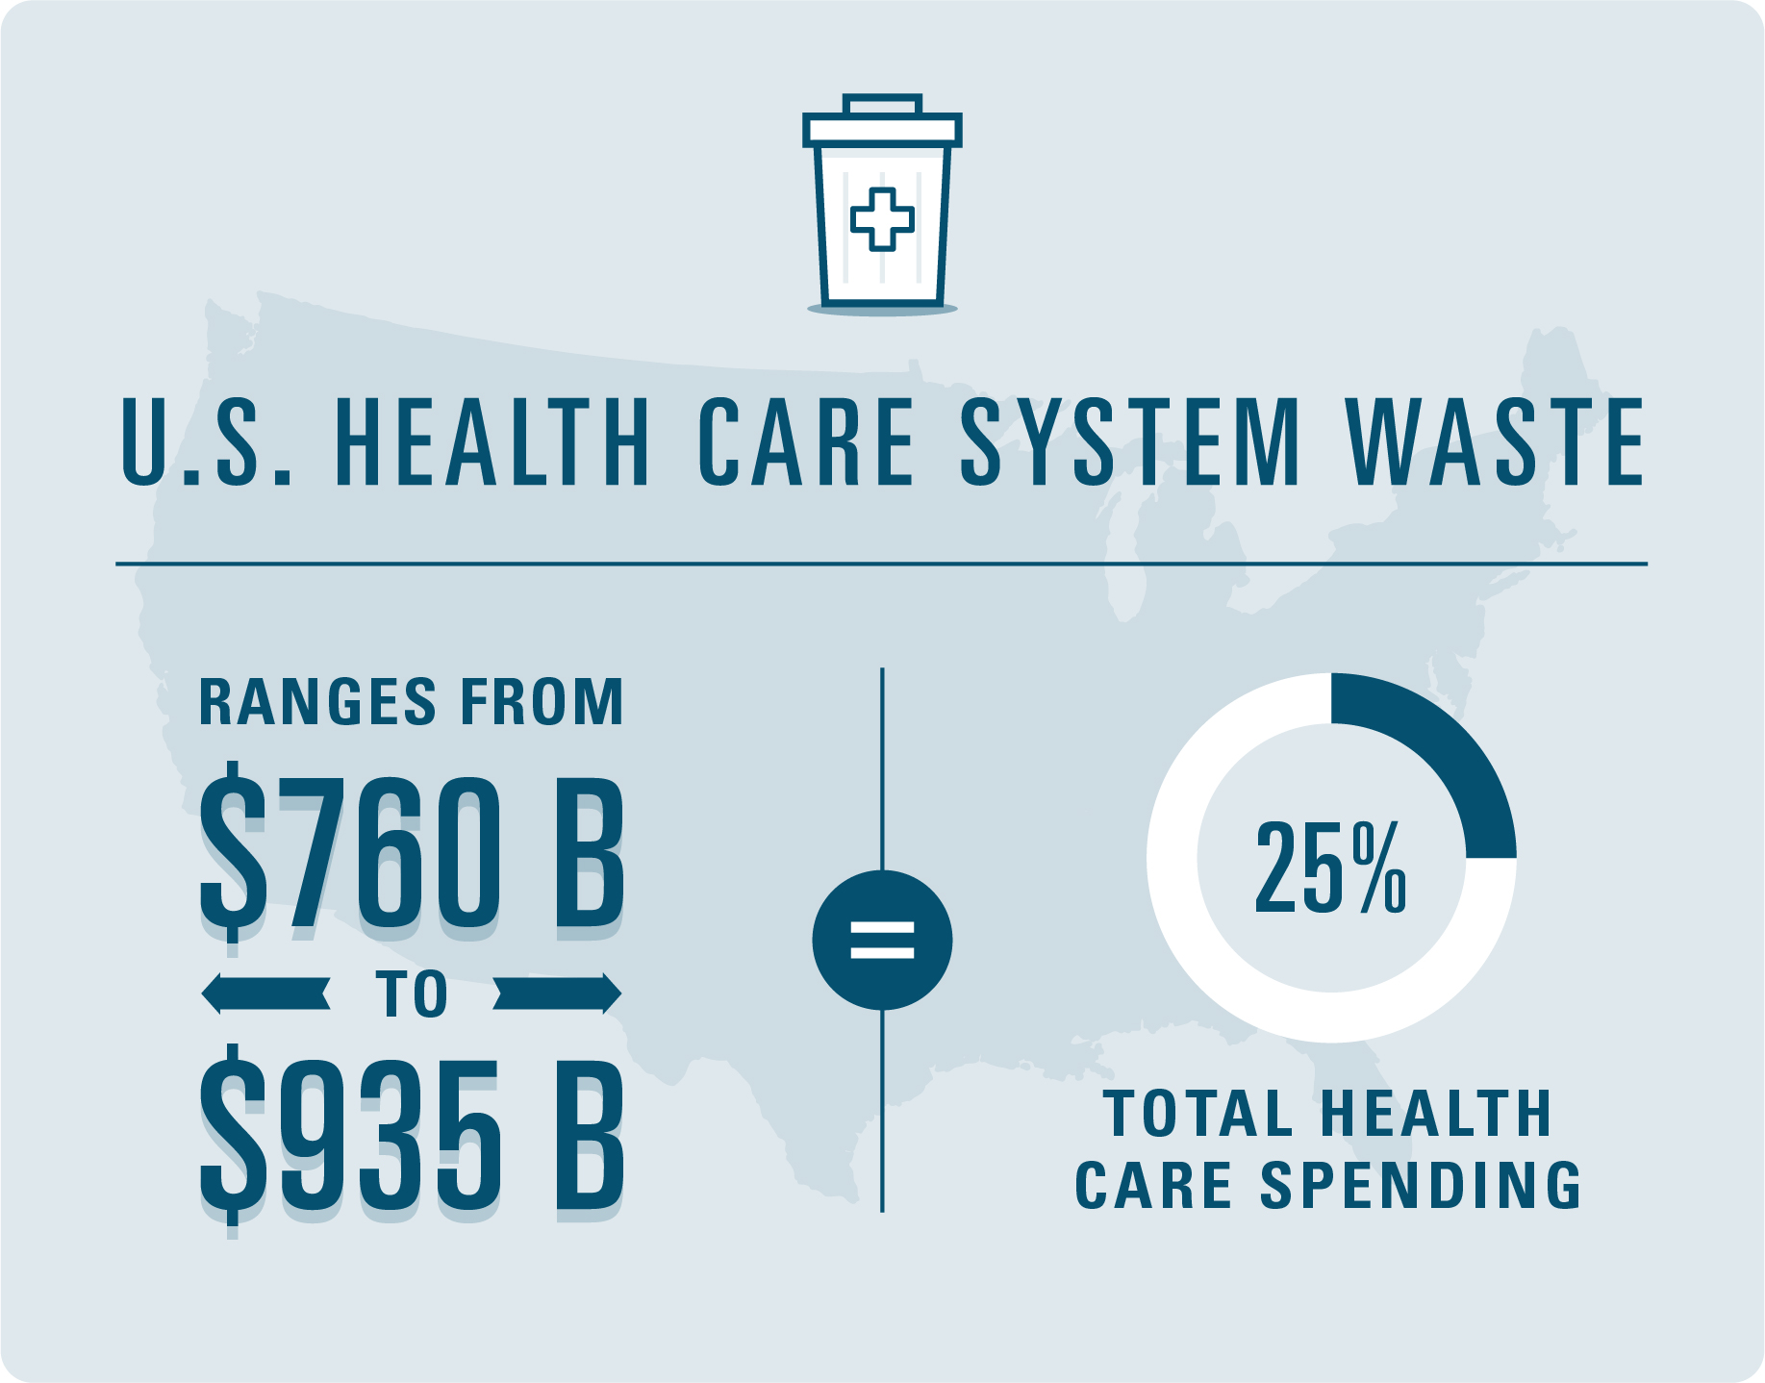
Administrative Burden and Waste

